Slide 1

Al Kirk
BACCEIC & ERIC South Sub-fund Administrator
NJSIG
Partner – Account Executive
Conner Strong & Buckelew
BACCEIC & ERIC SOUTH
Virtual Meeting
Hiring, Onboarding and Beyond: Understanding Essential Human Resource Protocols
Thursday, May 29, 2025

Slide 2
WELCOME
Al Kirk
BACCEIC & ERIC South Sub-fund Administrator
NJSIG
Partner – Account Executive
Conner Strong & Buckelew
BACCEIC & ERIC SOUTH
In-Person Meeting
Protecting Children from Abuse
in New Jersey
Wednesday, May 7, 2025

Slide 3
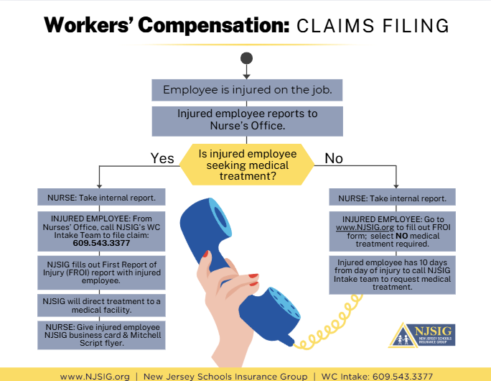
SUB-FUND ADMINISTRATOR REPORT
RECENT INTAKE TRAINING
Tt
NJSIG EXECUTIVE UPDATE
SAFETY TRAINING
Professional Development Courses
Date | Class Topic | Time
6/4/2025 | Productive Meetings Best Practices | 8:30 - 10:00 am
6/4/2025 | Employee Conduct and Violence Prevention in the Workplace | 1:00 - 2:30 pm
6/10/2025 | Ethical Decision Making | 9:00 - 11:30 am
6/16/2025 | Introduction to Understanding Conflict | 1:00 - 3:00 pm
6/18/2025 | Employee Conduct and Violence Prevention in the Workplace | 9:00 - 10:30 am
6/20/2025 | Implicit Bias in the Workplace | 1:00 - 2:30 pm
6/23/2025 | Special Event Management | 1:00 - 3:00 pm
7/7/2025 | Implicit Bias in the Workplace | 1:00 - 2:30 pm
7/8/2025 | Preparing for First Amendment Audits | 9:00 - 11:00 am
7/10/2025 | Employee Conduct and Violence Prevention in the Workplace | 9:00 - 10:30 am
7/15/2025 | Microlearning Theory and Practice | 1:00 - 3:00 pm
7/28/2025 | Dealing with Difficult People and De-Escalation | 10:00 - 11:30 am
7/29/2025 | Employee Conduct and Violence Prevention in the Workplace | 1:00 - 2:30 pm
The courses above provide Qualified Purchasing Agent (QPA) Continuing Education Credits.
PRESENTATION
Protecting Children from Abuse
In New Jersey
Presenter:
Paul Shives
Senior Director of Safety
J.A. Montgomery Risk Control

Slide 4
SUB-FUND ADMINISTRATOR REPORT
RECENT INTAKE TRAINING
NJSIG EXECUTIVE UPDATE
SAFETY TRAINING
Employee Safety (PEOSH) Training
Date | Class Topic | Time
6/3/2025 | Hazard Communication/Globally Harmonized System (GHS) | 8:30 - 10:00 am
6/4/2025 | Fire Safety | 10:30 - 11:30 am
6/6/2025 | Ladder Safety/Walking & Working Surfaces | 8:30 - 10:30 am
6/9/2025 | Personal Protective Equipment | 1:00 - 3:00 pm
6/10/2025 | Lock Out/Tag Out (Control of Hazardous Energy) | 1:00 - 3:00 pm
6/11/2025 | Mower Safety | 8:30 - 9:30 am
6/11/2025 | Fire Extinguisher Safety | 10:00 - 11:00 am
6/13/2025 | Fall Protection Awareness | 10:00 - 12:00 pm
6/16/2025 | Hazard Communication/Globally Harmonized System (GHS) | 7:30 - 9:00 am
6/17/2025 | Bloodborne Pathogens | 1:00 - 2:00 pm
6/23/2025 | Personal Protective Equipment | 8:30 - 10:30 am
6/23/2025 | Shop and Tool Safety | 11:00 - 12:00 pm
6/25/2025 | Lock Out/Tag Out (Control of Hazardous Energy) | 1:00 - 3:00 pm
6/26/2025 | Chipper Safety | 7:30 - 8:30 am
6/26/2025 | Chainsaw Safety | 9:00 - 10:00 am
6/26/2025 | Mower Safety | 10:30 - 11:30 am
6/26/2025 | Hazard Communication/Globally Harmonized System (GHS) | 1:00 - 2:30 pm
6/27/2025 | Fire Safety | 8:30 - 9:30 am
6/27/2025 | Fire Extinguisher Safety | 10:00 - 11:00 am
6/27/2025 | Bloodborne Pathogens | 1:00 - 2:00 pm
6/30/2025 | Ladder Safety/Walking & Working Surfaces | 1:00 - 3:00 pm
PRESENTATION
Protecting Children from Abuse
In New Jersey
Presenter:
Paul Shives
Senior Director of Safety
J.A. Montgomery Risk Control

Slide 5
SUB-FUND ADMINISTRATOR REPORT
RECENT INTAKE TRAINING
NJSIG EXECUTIVE UPDATE
SAFETY TRAINING
Employee Safety (PEOSH) Training
Date | Class Topic | Time
7/9/2025 | Bloodborne Pathogens | 8:30 - 9:30 am
7/9/2025 | Hazard Communication/Globally Harmonized System (GHS) | 1:00 - 2:30 pm
7/11/2025 | Personal Protective Equipment | 8:30 - 10:30 am
7/11/2025 | Fire Safety | 11:00 - 12:00 pm
7/14/2025 | Mower Safety | 8:30 - 9:30 am
7/14/2025 | Shop and Tool Safety | 10:00 - 11:00 am
7/14/2025 | Lock Out/Tag Out (Control of Hazardous Energy) | 1:00 - 3:00 pm
7/15/2025 | Back Safety/Material Handling | 9:00 - 10:00 am
7/17/2025 | Bloodborne Pathogens | 7:30 - 8:30 am
7/17/2025 | Asbestos Awareness | 9:00 - 11:00 am
7/17/2025 | Hazard Communication/Globally Harmonized System (GHS) | 1:00 - 2:30 pm
7/22/2025 | HazMat Awareness with Hazard Communication/Globally Harmonized System (GHS) | 8:30 - 11:30 am
7/22/2025 | Fire Extinguisher Safety | 1:00 - 2:00 pm
7/23/2025 | Personal Protective Equipment | 10:00 - 12:00 pm
7/24/2025 | Ladder Safety/Walking & Working Surfaces | 8:00 - 10:00 am
7/24/2025 | Fire Safety | 10:30 - 11:30 am
7/25/2025 | Hazard Communication/Globally Harmonized System (GHS) | 8:30 - 10:00 am
7/25/2025 | Bloodborne Pathogens | 10:30 - 11:30 am
7/29/2025 | Chainsaw Safety | 1:00 - 2:00 pm
7/30/2025 | Lock Out/Tag Out (Control of Hazardous Energy) | 8:30 - 10:30 am
7/30/2025 | Mower Safety | 11:00 - 12:00 pm
7/31/2025 | Fire Extinguisher Safety | 8:30 - 9:30 am
7/31/2025 | Fall Protection Awareness | 10:00 - 12:00 pm
PRESENTATION
Protecting Children from Abuse
In New Jersey
Presenter:
Paul Shives
Senior Director of Safety
J.A. Montgomery Risk Control

Slide 6
SUB-FUND ADMINISTRATOR REPORT
RECENT INTAKE TRAINING
NJSIG EXECUTIVE UPDATE
SAFETY TRAINING
Driving Safety Training
Date | Class Topic | Time
6/16/2025 | CDL: Drivers' Safety Regulations | 9:30 - 11:30 am
6/25/2025 | Driving Safety Awareness | 9:00 - 10:30 am
6/30/2025 | CDL: Supervisors' Reasonable Suspicion | 8:30 - 10:30 am
7/8/2025 | CDL: Drivers' Safety Regulations | 8:30 - 10:30 am
7/18/2025 | Driving Safety Awareness | 8:30 - 10:00 am
PRESENTATION
Protecting Children from Abuse
In New Jersey
Presenter:
Paul Shives
Senior Director of Safety
J.A. Montgomery Risk Control

Slide 7
SUB-FUND ADMINISTRATOR REPORT
RECENT INTAKE TRAINING
NJSIG EXECUTIVE UPDATE
END OF SUMMER - LUNCH & LEARN “BBQ”
”Who Gets to Know What? Understanding the Law on Confidentiality”
In this session, participants will learn about the many state and federal laws that impact confidentiality and information sharing, and how to apply them in the school setting. The session will include a review of FERPA, HIPAA, 42 CFR Part 2, the Memorandum of Agreement between Education and Law Enforcement, legislation and guidance impacting reporting and record keeping.
Specific topics to be addressed will include:
Understanding FERPA, IDEA and Section 504 and determining who has a legitimate educational interest in receiving student information
Information sharing between schools and law enforcement
Addressing substance use, mental health and other medical information for students and staff members and the parameters of confidentiality
Understanding what information must be shared and what information cannot be shared under the Open Public Records Act
Addressing confidentiality while litigation is pending or ongoing and after settlement agreements have been reached
Appropriate information sharing between the school district and the insurance provider.
Save the Dates:
BACCEIC: Tuesday, September 30th from 10am to 12pm
ERIC South: Friday, October 3rd from 10am to 12pm
PRESENTATION
Protecting Children from Abuse
In New Jersey
Presenter:
Paul Shives
Senior Director of Safety
J.A. Montgomery Risk Control

Slide 8
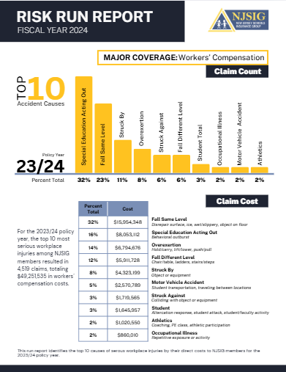
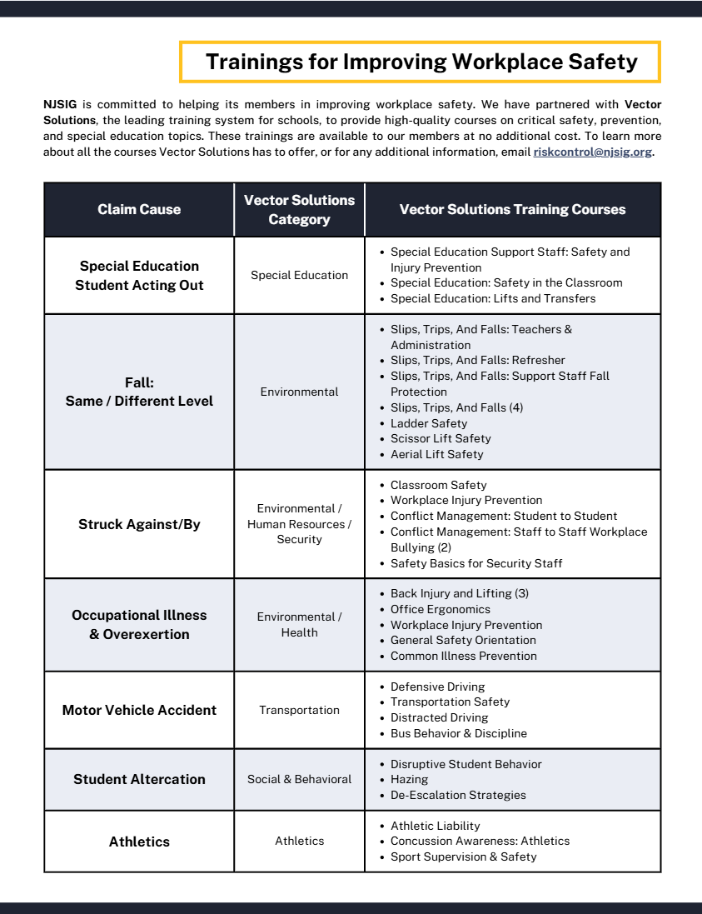
Al Kirk
BACCEIC & ERIC South Sub-fund Administrator
NJSIG
Partner – Account Executive
Conner Strong & Buckelew
NJSIG EXECUTIVE UPDATE
NJSIG UPDATE
Joe Semptimphelter
Senior Business Development Specialist
jsemptimphelter@njsig.org
609-386-6060 x3044
RISK RUN REPORT

Slide 9
NJSIG UPDATE
Joe Semptimphelter
Senior Business Development Specialist
jsemptimphelter@njsig.org
609-386-6060 x3044
NJSIG EXECUTIVE UPDATE
RISK RUN REPORT
RECENT INTAKE TRAINING

Slide 10
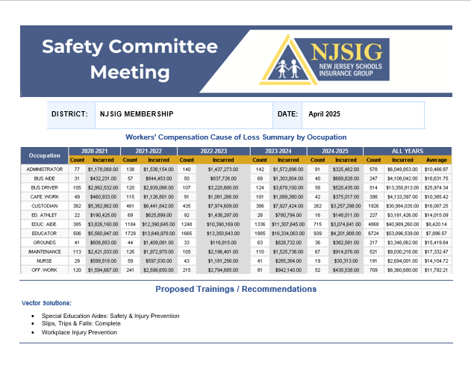
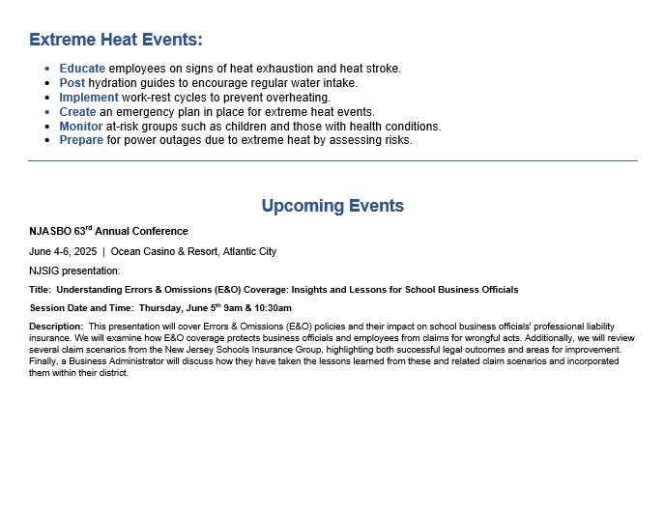
SUB-FUND ADMINISTRATOR REPORT
RISK RUN REPORT
NJSIG EXECUTIVE UPDATE
RECENT INTAKE TRAINING
SAFETY FLYER

Slide 11
SUB-FUND ADMINISTRATOR REPORT
RECENT INTAKE TRAINING
NJSIG EXECUTIVE UPDATE
SAFETY FLYER
PRESENTATION
Protecting Children from Abuse
In New Jersey
Presenter:
Paul Shives
Senior Director of Safety
J.A. Montgomery Risk Control

Slide 12
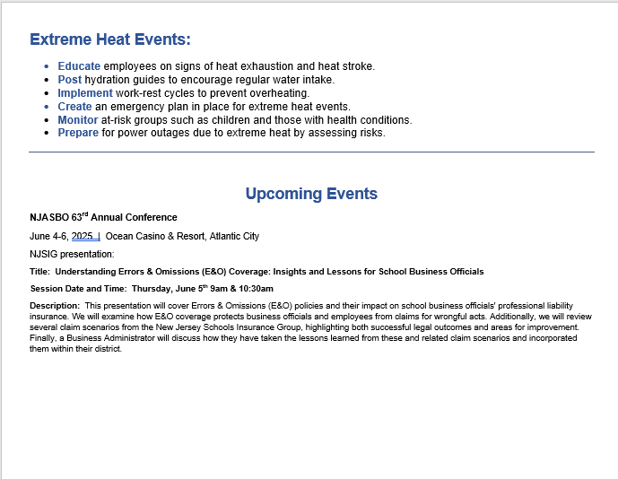
SAFETY FLYER
Latonya Brennan | Dan Regan | Barbara Fitzpatrick
Amanda DeNapoli | Eva Jakowluk
NJSIG EXECUTIVE UPDATE
PRESENTATION
Hiring, Onboarding, and Beyond:
Understanding Essential
Human Resources Protocols

Slide 13

Law, Ethics and Governance for All Leaders, including an Overview of New and Emerging Issues
HIRING, ONBOARDING AND BEYOND:
Understanding Essential
Human Resources Protocols
May 29, 2025

Slide 14
Presenters/Partnership
LEGAL ONE and New Jersey Schools Insurance Group
David Nash, Esq., Director of Legal Education and National Outreach
Rebecca Gold, LEGAL ONE Consultant

Slide 15
DISCLAIMER
This presentation is intended as a summary of law only and is not meant as legal advice. Please consult your attorney to obtain legal advice.
Participants are authorized to use the LEGAL ONE materials provided in this training to offer turnkey training within the respective participant's school district or place of employment, provided that participants provide proper credit to LEGAL ONE for having developed said materials and further provided that such turnkey training is offered at no charge.

Slide 16
Key Topics
Staff recruitment and hiring
Onboarding
Mandated professional learning.
Key questions to be addressed include:
  What processes need to be followed when screening potential new hires?
  What are the key steps to the onboarding process?
  How do we ensure that staff members are properly trained and understand how to address a wide range of legal issues that may arise, including bullying, substance use, suicidal ideation, threat assessment and more.
  What is the potential liability for the school district when this process breaks down?- How do you effectively use the resources available through NJSIG in this process?

Slide 17
The Importance of Human Resources
There is no “easing in” – Day 1 is go time!
Staffing Quality matters in order to:
  Promote academic success of students
  Ensure safe, healthy, respectful environment
HR is an art as much as a science
Creativity and Attention to Detail Are Essential
Relationships, Relationships, Relationships!

Slide 18
HR Budgeting – A True Balancing Act!
Open Positions
Staffing Efficiencies
Potential Health and Safety, Legal Liability Exposure
  E.g. lack of school nurse
Understanding budget caps
Breakage/Retirements
During Negotiations
Projecting State Funding
Going Beyond Step 1
Emergencies!

Slide 19
For Every Season …
  Starting the School Year/Fall (Onboarding, Essential PD, Prep Time, Plan B for Staffing Gaps, Staff Accommodations, New Mandates, Working with Unions, Politics, etc.)
  Winter (Attendance, Performance Issues, Staff Complaints, Holidays, Budgeting, etc.)
  Spring (Recruitment, Hiring, Renewal/Nonrenewal, Summative Evals, Tenure Charges, etc.)
  Summer (Goal Setting, Reflection, Reorganization, CAPs, prep for opening, Summer Shenanigans)

Slide 20
scenarios

Slide 21
What If …
Fall - A physical education teacher requires a student with a physical disability to “sit out” of phys ed class for the first week of school, since he hasn’t had time to meet with anyone from the district level to explain the complicated accommodations that are in the student’s 504 plan, including detailed strategies for physically guiding the student?
Winter – Over the first 3 months of the school year, you have heard both raves and complaints about Joseph Martin, a retired police officer who pursued a second career in education and is a newly hired physical education teacher and assistant football coach. Many student athletes and their parents have raved about how caring and passionate he is working with athletes. On the other hand, one day in October three students come in to meet with the Assistant Principal and complain that he is “always saying scary stuff” about how “one mistake could end your life” and how “being an idiot for a day can last a lifetime.” The AP and Principal like Mr. Martin and don’t want to lose him. What do they do?

Slide 22
What If …
3. Spring - The high school principal asks to meet with you to review your hiring protocols. She says the school principals are upset that they don’t have enough say in hiring decisions for teachers in their buildings. They wonder why the HR director has to “micromanage” and be present and run every new teacher interview.
4. Summer – Mr. Williams takes a trip every summer to a tropical location. This past Summer, he is spending time in Aruba. On the last day of his vacation, he posts a picture to his personal social media account on the beach, shirtless, with a drink in his hand. Under the image he writes “Paradise ends today … Back to the ugly reality of being a teacher in 2024. Lord help me!” The post is brought to your attention by an irate parent, whose son will be in Mr. Williams class in September.

Slide 23
SPRING/SUMMER - hiring

Slide 24
Posting
Requirements in District Policy, Collective Bargaining Agreements
Accuracy
  Is job description up to date?
Consider “preferred” versus “must have”
Timeline
Consistency
Publications
Internal v. External

Slide 25
Recruitment
Internal
Job Fairs
Colleges
Outside New Jersey
Seeking Diverse Applicant Pool

Slide 26
Interview Process
Screening
Interview Team/Assigned Roles
Questions
Scoring Rubrics
Demos
Walk Throughs
Final Round

Slide 27
References/Background Checks
Criminal Background Checks
Social Media Postings
References
  Immediate Supervisor
Most Recent Evaluation
Pass the Trash Law
  ALL prior positions with contact with children (e.g. summer job at convenience store)
  Any pending investigations or findings of child abuse or sexual misconduct with children
  Broad view of pending investigations (e.g. investigating comments on social media that were not directed at students, but could be seen by students)
  Don’t Wait Until Last Minute to Do This!!!

Slide 28
Criminal Background Checks
FAQs from Office of Student Protection, NJDOE - https://www.nj.gov/education/crimhist/
Which applicants or employees are required to undergo the Criminal History Record Check?
  If the job position is mentioned in the statute (N.J.S.A.18A:6-7.2) i.e. teaching staff member, substitute teacher, teacher aide, child study team member, school physician, school nurse, custodian, school maintenance worker, cafeteria worker, school law enforcement officer, school secretary or clerical worker, regardless of pupil contact, the individual must submit to the Criminal History Record Check. In addition, any individual that has “regular pupil contact” must also undergo the Criminal History Record Check. “Regular pupil contact” is determined by the employing education facility in consultation with the school attorney.
What other employees have regular pupil contact?
Which “volunteers” does this apply to???

Slide 29
Pass the Trash
In 2018, New Jersey passed P.L.2018, c.5, known as the “Pass the Trash Act,” effective June 1, 2018:
  Districts must require applicants to provide certain information about their employment history before the employee may be hired for a position that requires regular contact with students;
    Current employer;
    All former schools that employed the applicant within the last twenty (20) years;
      Must provide executed authorization consenting to disclosure of employment history
    All former employers where the applicant had direct contact with children within the last twenty (20) years.

Slide 30
Disclosure – Pass the Trash
A.B. v. BOE of the City of Hackensack, Commissioner 10/21/2021, aff’d App. Div. 10/5/2023
Teacher challenged BOE release of information concerning her former employment as a teacher in the Hackensack school district; sought employment with the Clifton BOE. (2019) BOE contended that it was obligated to release the information.
Pursuant to “Pass the Trash”, N.J.S.A. 18A:6-7.6 through 7.13, Clifton submitted a questionnaire to Hackensack inquiring about whether petitioner had been the subject of a child abuse or sexual misconduct investigation. The Board answered “Yes” and that petitioner had resigned while the allegations were pending or under investigation. As a result, Clifton withdrew its offer to hire the teacher.
While employed in Hackensack (2013) teacher shared two sexually explicit posts on social media to which several students had access. “Kiss me, I’m Irish, F*** me, I’m Irish,” “Women say, men only think with their penis – Ladies, don’t be afraid to blow their minds.”
Hackensack board became aware of posts, considered taking disciplinary action. Teacher, her union representatives, and her legal counsel met with the Board and its legal representation, resulting in a settlement agreement (4/25/13) including teacher’s resignation. Agreement contained a confidentiality provision with the disclaimer “to the extent provided by law.”
Notes:
Brito-Herrera v. West New York
Authority - Commissioner of Education
Issue - Whether board impermissibly reduced salary of asst. CSA in promoting her to CSA
Fact1 - Asst. CA was tenured in that position & at that salary.
Fact2 - Board promoted Asst. CSA to CSA
Fact3 - Board reduced salary to match CSA salary cap.
Rule - Tenure rights accrued in one administrative position do not transfer to another,
Analysis - By attempting to transfer her Asst. CSA salary to Superintendent position, petitioner seeks to extend her accrued tenure from one administrative position to another.
Conclusion - Board did not violate tenure rights in reducing Asst. CSA salary upon promotion to CSA.

Slide 31
Disclosure – Pass the Trash
A.B. v. BOE of the City of Hackensack, Commissioner 10/21/2021, aff’d App. Div. 10/5/2023
Commissioner finds that it is reasonable that the Board conducted an investigation into sexual misconduct based on petitioner’s actions. Petitioner’s social media posts could meet the definition of electronic communications that are directed toward or with a student that are designed to establish a sexual relationship with the student, such as making sexually suggestive comments. It is sufficient that her actions could meet the definition and that the Board opened an investigation.
Commissioner agrees with the ALJ that N.J.S.A. 18:6-7.12 did not exempt settlement agreements entered into before June 1, 2018 from the mandatory disclosure provisions of the “Pass the Trash” statute. Petitioner also consented to the disclosure of information by signing an authorization form and that her settlement agreement provided a waiver of its confidentiality provision when required by law.
Appellate Division affirmed.
Notes:
Brito-Herrera v. West New York
Authority - Commissioner of Education
Issue - Whether board impermissibly reduced salary of asst. CSA in promoting her to CSA
Fact1 - Asst. CA was tenured in that position & at that salary.
Fact2 - Board promoted Asst. CSA to CSA
Fact3 - Board reduced salary to match CSA salary cap.
Rule - Tenure rights accrued in one administrative position do not transfer to another,
Analysis - By attempting to transfer her Asst. CSA salary to Superintendent position, petitioner seeks to extend her accrued tenure from one administrative position to another.
Conclusion - Board did not violate tenure rights in reducing Asst. CSA salary upon promotion to CSA.

Slide 32
Interview Do’s and Don’ts
Do not ask about
  Prior Salary History (see P.L. 2019, c. 199)
  Religious and Political Views
  Health Issues, Family Planning, pregnancy, etc.
Do ask about
  Salary Expectations
  Ability to engage with diverse communities
  Awareness of Employee Benefits

Slide 33
Demos/Skills Test
Many employees sound wonderful, but don’t actually have required skills
Consistently use demos/skills tests
Have rubrics for scoring and apply in all cases
Have process for demos for times when students are not present (simulated classroom with adults playing student roles)

Slide 34
Failure to Properly Use Skills Test
Marcus Royal v. Camden City Public Schools Division on Civil Rights, Docket No, ED08RB-64671, June 29, 2018
Facts: District eliminated prior technology positions, created new positions that district argued were substantively different. Prior employees were allowed to apply for new positions. Plaintiff argued that less qualified White applicants were hired for the newly created positions.
District had all applicants complete skills test.
District was unable to produce the scores of other candidates
District interviewers admitted they were never told the scores of applicants on hiring exercise
District was unable to justify portions of score for Complainant – e.g., not given credit for proper certification when he in fact had preferred cert.
District rehiring data showed that 75% of African American employees in prior tech role were not rehired for new roles, while 100% of Caucasian employees were rehired
Holding: Director of DCR found probable cause that plaintiff was denied new position due to race.

Slide 35
Equal Pay Act
P.L. 2018, c.9 – Effective July 1, 2018
Be careful about placement on salary guide
Illegal to discriminate in compensation based on any protected class under the NJ Law Against Discrimination.
Employee must establish:
  Protected Class Status; and
  That there is a wage differential for similarly situated employees doing substantially similar work.
What is “substantially similar work”?
Employee 6 years to file complaint
  Ensure legally defensible rationale for salary at time of hire

Slide 36
Hiring Recommendations
Reliance on Rubric, scoring
Transparency in Process
Opportunity for all interview team members to be heard, discuss views prior to final recommendations
Understanding that ONLY THE SUPERINTENDENT makes final decision on recommendations to Board of Education
Beware of Hiring without completion of criminal background check, Pass the Trash, receipt of transcripts, etc.
  If necessary, indicate on agenda hiring “pending receipt” or “pending verification”
Remember to send Letters to those NOT HIRED

Slide 37
Summer/fall - onboarding considerations

Slide 38
Onboarding Considerations
The basics – Payroll, benefits, work location, parking
Your procedures/protocols
Your climate/culture
Your expectations
State Laws
Mid-Year Hires
Your ongoing support – Onboarding is not one day, week, or month
  Consider establishing a New Hire Academy

Slide 39
Essential Professional Development
See mandatory training requirements - New Jersey Professional Development Requirements in Statute and Regulations
Addressing Urgent/Crisis Situations
  Students with Special Needs (IEP, 504, Health Plan, Multilingual Learner, etc.)
  Suicidal Ideation
  Threat Assessment
  Substance Use
  Child Abuse/Neglect
New Mandates
Understanding Boundaries
Address vendors and their employees performing tasks otherwise performed by school district employees

Slide 40
Essential Professional Developmenst
PD Requirements by Topic:
Health
Interscholastic Activities
Prevention: Suicide, Substance Abuse, Harassment, Intimidation, and Bullying
Reading Disabilities
School Safety, Security and Code of Student Conduct
Additional Topics

Slide 41
Confidentiality Training, Agreement, Protocols
Dangers of violating FERPA, HIPAA
Danger of obstructing or undermining ongoing investigations
Potential for civil liability
Consider having district confidentiality agreement/notice and sign off for all staff members
Remember to address confidentiality for vendors and their employees who have access to confidential information

Slide 42
Expanded Suicide Prevention Training, Notice, Reporting
P.L. 2023, c.111 (7/20/2023) Requires certain additional school district personnel to complete training program on suicide prevention.
  Expansion of existing requirements in N.J.S.A. 18A:6-112 for teaching staff members to annually receive PD on suicide prevention, link to HIB, addressing at-risk populations
  Any other employee of district OR contracted service provider who has regular contact with children must receive one-time PD on suicide prevention within 12 months of date of hire
  All teaching staff members and other employees with regular/direct contact with children must ANNUALLY receive electronic or hard copy of the school district’s reporting and suicide prevention, awareness, and response protocols including, but not limited to, contact information for each school’s designated staff who should be notified whenever an employee believes a student may be at risk for suicide
  Duty to warn and protect and report suicidal ideation
  Immunity from civil or criminal liability for those who report

Slide 43
Paras and Subs
Provide opportunities for the principal and other administrators to meet with paraprofessionals and substitute teachers that are assigned to their building
Enhance the paraprofessional and substitute training that is provided to ensure that key health and safety, school security, and operational protocols are effectively addressed
Invite administrators to participate in the substitute and paraprofessional training processes
Raise awareness of existing protocols for addressing concerns regarding behavior and/or performance of substitutes

Slide 44
Understanding Staff Leave Policies and Law
Sick Leave Expansion
  Foreseeability, “Black Out” dates, documentation
Family and Medical Leave
  See New Jersey Family Leave Act - New Jersey Office of Attorney General (njoag.gov)
  See Family and Medical Leave (FMLA) | U.S. Department of Labor (dol.gov)
Patterns
Documentation
Establishing Excessive Absenteeism
  See In the Matter of the Tenure Hearing of Lateefah Henderson, School District of the City of Newark, Essex County, 1/3/2024, (#2-24) (Arbitrator: Earl R. Pfeffer)
Notice
Support
Progressive Supervision

Slide 45
Prep Time
Classroom Set Up
  Educationally Sound, Affirming v. Political Messages, Student Safety
Reviewing IEPs and 504 Plans
  Sign Off that all reviewed
  Proactive meetings with case managers, experts to address students with major behavioral issues, other unique needs
Proper Use of Prep Period
  Lesson Plans, curriculum development, select meetings
  NOT coffee breaks, social gatherings, etc.
Other Assignments
  Expectations for other assignments – what does lunch duty or hall duty really mean?

Slide 46
Staff Support/Accommodations
Universal Supports for All Staff
Employee Assistance Program/Other Resources
Staff Mental Health
  See Depression, PTSD, & Other Mental Health Conditions in the Workplace: Your Legal Rights | U.S. Equal Employment Opportunity Commission (eeoc.gov)
Interactive Process
  No magic words
  Working together
Staff/Family Crisis Response
Staff Reentry After Extended Absence

Slide 47
Holidays/Religious Expressions
Religious Holidays
Religious Accommodation – Groff v. DeJoy
  Title VII requires an employer to show that providing requested religious accommodation will result in substantial increased costs to employer. USPS must satisfy that burden to justify required employee to work on Sundays.
Religious Expression
  Kennedy v. Bremerton SD (June 27, 2022). Case involved coach who engaged in prayer immediately after games on the 50-yard line. District determined not to renew coach due to his failure to follow district policy and continuing to engage in religious speech in violation of Establishment Clause. U.S. Supreme Court determined that district violated rights of coach under First Amendment

Slide 48
Other key HR issues

Slide 49
Addressing Staffing Gaps
Plan B, C and D
Increased Class Size
Ensuring Proper Certification
  See NJDOE Certification Requirements at Certification (nj.gov)
Coverage
  Nurse out sick, Principal at a conference, teacher leaving midday for family emergency
Use of Substitutes
  Employees
  Outside Agencies
  Understanding Your Protocols and Mandated Reports

Slide 50
Working with Unions
Chance for fresh start
Invite open dialogue, build relationships
Protect Member Rights
  Weingarten Rights
Know Your Collective Bargaining Agreements
  Length of workday, notice requirements, etc.
Avoid Anti-Union Animus

Slide 51
Weingarten Rights
  An employee’s right to representation in an interview applies to situations where the employee reasonably believes the investigation at the interview will result in disciplinary action.
  An investigatory interview is one in which a supervisor questions an employee to obtain information which could be used on a basis for discipline or asks an employee to defend his/her conduct.

Slide 52
Weingarten Rights
If the Supervisor denies the request and continues to ask questions, this is an unfair labor practice and the employee has a right to refuse to answer any questions.
The employee must clearly request representation before or during the interview in order to claim this right.
The employer/supervisor has no duty to inform the worker of this right.

Slide 53
Staff First Amendment Rights
Pickering v. Board of Education, 391 U.S. 563 (1968)
Pickering Balancing Test
Did the statement concern a matter of general public concern?
Was the employee speaking as a private citizen or during the course of his duties?
  See Also: Garcetti v. Ceballos (2006) – Statements by public employees made pursuant to their employment have no First Amendment Protection
Was the statement likely to disrupt a close working relationship?
Recent Case Law
  Melnyk - No First Amendment rights for teacher to alter required curriculum
  Czaplinski - Security guard terminated for comments related to police officer shooting
  O’Brien - First grade teacher terminated based on comments regarding students

Slide 54
Staff Performance Issues
Patterns may begin to emerge
Do issues involve:
  Competence
  Professionalism
  Insubordination
  Incapacity
  Conduct Unbecoming
  Staff/Student
  Healthy Workplace
  Discrimination

Slide 55
Investigating Staff Behavior
Who is the Proper Investigator???
  Follow Policy
  Healthy Workplace Environment v. Discrimination Claim (different processes) v. Performance Issue
No “drive by” notices!
Notify staff member if they are under investigation, provide reasonable opportunity to have representation present
  Understand role of rep (NOT to interfere, take over, answer Qs)
Advise staff member NOT to discuss matter during investigation, NOT to approach other parties or witnesses
Provide opportunity for written statement
Review all evidence, interview all parties prior to reaching conclusion
Provide staff member with final outcome and written conclusion regarding each allegation
Are you consistent in addressing comparable staff behavior?
  No anti-union animus, playing favorites, implicit bias, etc.

Slide 56
Non-Certificated Staff Members
P.L. 2020, c.66 (8/13/2020) – Employees who are not teaching staff members (non-certificated staff) shall have the right to submit to binding arbitration (through the contractual grievance procedure) any dispute regarding whether there is just cause for a disciplinary action, including, but not limited to:
  reprimands, withholding of increments, termination or non-renewal of an employment contract, expiration or lapse of an employment contract or term, or lack of continuation of employment,

Slide 57
Just Cause Test
1. FAIR NOTICE Did management make the worker aware of the rule or policy which they are being accused of violating?
2. PRIOR ENFORCEMENT Has management recently enforced the rule or policy or penalized other workers for violating the same rule or policy?
3. DUE PROCESS Did management conduct an interview or hearing before issuing the discipline, take action promptly and list charges precisely?
4. SUBSTANTIAL PROOF Was management’s decision to accord discipline based on credible and substantial evidence?
5. EQUAL TREATMENT Is the punishment management is proposing consistent with the punishment other workers received for the same or substantially similar offense?
6. PROGRESSIVE DISCIPLINE During the disciplinary process, did management issue at least one level of discipline that allowed the employee an opportunity to improve?
7. MITIGATING AND EXTENUATING CIRCUMSTANCES Was the discipline proportional to the gravity of the offense, taking into account any mitigating, extenuating or aggravating circumstances?

Slide 58
Discrimination Claims and Protected Classes
Employers--including parochial schools and public-school districts--may not discriminate against staff or students based on:
  Race
  Creed
  Color
  National origin
  Ancestry
  Age
  Genetic information
  Pregnancy
  Sex
  Religion
  Disability
  Military service
  Atypical cellular blood trait
  Nationality
NJ LAD
  Marital/domestic partnership/civil union status
  Affectional or sexual orientation
  Gender identification or expression
  Hair

Slide 59
Laws You Should Be Aware Of
New Jersey Law against Discrimination – N.J.S.A. 10:5-12
New Jersey’s Anti-Bullying Bill of Rights
New Jersey Conscientious Employee Protection Act (CEPA)
New Jersey Equal Pay Act
New Jersey Civil Union Act of 2007
NJ CROWN Act
Americans with Disabilities Act
Title VI of the 1964 Federal Civil Rights Act
Title VII of the 1964 Federal Civil Rights Act
Title IX of the Education Amendments of 1972
Equal Pay Act of 1963 (EPA)
Equal Protection Clause of the 14th Amendment
The Age Discrimination in Employment Act of 1967 (ADEA)
The Individuals with Disabilities in Education Improvement Act (IDEIA/IDEA)
Section 504 of the Rehabilitation Act of 1973
Pregnant Worker’s Fairness Act (PWFA) – 2014

Slide 60
NJ Law Against Discrimination
Enacted in 1945, first of its kind state civil rights law
Provides strong protections based on a wide range of protected characteristics
Covers employment, places of public accommodation, housing, business transactions
Amended in 1992 to cover sexual orientation
Amended in 2006 to cover gender identity
2007 – LW v. Toms River – applies to students, requires comprehensive, pro-active approach
Amended in 2018 – Equal Pay Act
Amended in 2019 – CROWN Act
Expands protections provided under federal law
NO NEED TO PROVE INTENT TO DISCRIMINATE
Generally relied on by plaintiffs more than comparable federal law

Slide 61
NJLAD Punitive Damages Requirements
No Insurance Coverage for Punitive Damages!
A LAD claim for Punitive Damages requires the Plaintiff to prove two things by clear and convincing evidence
  Actual participation by upper management or willful indifference, and
  Especially egregious conduct
    N.J. Stat. Sec. 2A:15-5.12

Slide 62
Summer HR CONSIDERATIONS

Slide 63
Avoiding/Addressing
Summer Shenanigans!
Less structured, more relaxed
Dress Code
Summer Schedule
Staff Social Gatherings
Social Media Posts

Slide 64
Reorganization
Legitimate Non-Discriminatory Reasons for Reorganization
  Not pretext to circumvent tenure/seniority rights
New Positions
New Job Descriptions
New Hires
Staff Transfers
  Managerial prerogative, BUT …

Slide 65
EMPLOYEE TRANSFER AND TITLE VII
Muldrow v. City of St. Louis – 4/17/24
OVERVIEW
Sergeant Jatonya Clayborn Muldrow maintained that her employer, the St. Louis Police Department, transferred her from one job to another because she is a woman. From 2008 through 2017, Muldrow worked as a plainclothes officer in the Department’s specialized Intelligence Division. In 2017, the new Intelligence Division commander asked to transfer Muldrow out of the unit so he could replace her with a male police officer. Against Muldrow’s wishes, the Department approved the request and reassigned Muldrow to a uniformed job elsewhere in the Department.

Slide 66
Muldrow (cont’d)
While Muldrow’s rank and pay remained the same in the new position, her responsibilities, perks, and schedule did not. After the transfer, Muldrow no longer worked with high-ranking officials on the departmental priorities lodged in the Intelligence Division, instead supervising the day-to-day activities of neighborhood patrol officers. She also lost access to an unmarked take-home vehicle and had a less regular schedule involving weekend shifts.
City argued that since rank and pay not impacted, there was no materially significant harm

Slide 67
Muldrow (cont’d)
Supreme Court Held: An employee challenging a job transfer under Title VII must show that the transfer brought about some harm with respect to an identifiable term or condition of employment, but that harm need not be significant.
Majority opinion indicated that prior decision on transfer of school principal was wrongly decided. If transfer occurs and person no longer doing traditional principal work, could satisfy the required showing of harm, even with same salary.
GROUP DISCUSSION:
  Implications for school district decisions to transfer staff members?
  What protocols should be in place moving forward?

Slide 68
Key Takeaways
No need to prove significant harm as a result of a transfer, only that the transfer was motivated by discriminatory intent
Critical to document legitimate, non-discriminatory reasons for transfers
Relying solely on managerial prerogative and transfer and no loss of rank or pay may not be enough

Slide 69
Implementing Corrective Action Plans
Putting in place individualized PD, supports
Planning check-ins
Ensuring employee needs to do more than show up
  Include demonstrations of reflection, knowledge, application of skills, demonstration of professionalism, etc.

Slide 70
Reflection/Goal Setting
What is and is not working well
Litigation
Effectiveness of Recruitment, PD, Other HR Protocols/Initiatives
Identifying Personal Strengths and Opportunities for Growth
Summer Admin Retreat!

Slide 71
questions???

Slide 72

Conclusion
Thank you for choosing professional development with LEGAL ONE!
Visit our website for more courses that can support your work at http://www.njpsa.org/legalonenj/
Participants are authorized to use the LEGAL ONE materials provided in this training to offer turnkey training within the respective participant's school district or place of employment, provided that participants provide proper credit to LEGAL ONE for having developed said materials and further provided that such turnkey training is offered at no charge.
If you have any questions about this presentation or suggestions for future seminars, please send an email to legalone@njpsa.org

Slide 73
THANK YOU!

